Slide 1



assignment
november 2024
D
ATA BAS
E
tinder
DONE BY-
S.UDHAYA SANKARI
GEETHIKA YARABOLU
NIKSHITA KADALI

Slide 2

ABOUT THE APP
Introduction
Tinder is a widely recognized mobile dating application that facilitates connections between individuals seeking romantic relationships. Launched in 2012, it has gained popularity due to its innovative approach to online dating, primarily through its user-friendly interface and unique swiping mechanism

Slide 3

DATABASES USED AND THEIR ALTERNATIVES

Slide 4


PURPOSE
Store structured data, such as user profiles, preferences, and relationships (matches)
USE CASE
Tracking structured user information.
Managing relationships between users (e.g., matches).
BENEFITS
Provides strong consistency and reliable query performance for user-related data that needs to remain accurate and persistent.
Relational Databases (SQL-Based)
alternate

Slide 5

why not cockroach database or maria database ?
Operational Reliability
Community and Support
Risk Management
cockroach db
maria db

Slide 6

PURPOSE
Handle non-relational, distributed data like conversations, likes, and user activity.
USE CASE
Storing large-scale, real-time user activities.
Retrieving match lists and chat histories quickly across devices.
BENEFITS
Easily scales horizontally to manage massive user data loads and provides quick access to frequently accessed or updated information.
NoSQL Databases
alternate

Slide 7
why not couchbase or arango database ?
Maturity in Distributed Systems
Optimized for Scale
Seamless AWS Integration
couchbase
arango db

Slide 8

PURPOSE
Enable fast caching and session management with low latency.
USE CASE
Caching user sessions to reduce database load.
Storing temporary data like online status and recent activity.
Handling geospatial data for location-based matching
BENEFITS
Provides near-instant data retrieval, which is essential for real-time features like location-based matching and maintaining active user sessions.
In-Memory Databases
alternate

Slide 9
why not hazelcast or trantool database ?
Simplicity and Effectiveness
Community and Proven Use Cases
Geospatial Data Handling
hazelcast
tarantool

Slide 10

PURPOSE
Model relationships between users efficiently for matchmaking.
USE CASE
Finding mutual connections or friends.
Optimizing recommendations by analyzing user interaction graphs.
BENEFITS
Facilitates complex queries involving user relationships and efficiently manages interconnected data to enhance the matchmaking experience.
Graph Databases
alternate

Slide 11
why not tiger graph or janus graph database ?
Efficiency for Social Graphs
AWS Ecosystem Alignment
tiger graph
janus graph

Slide 12
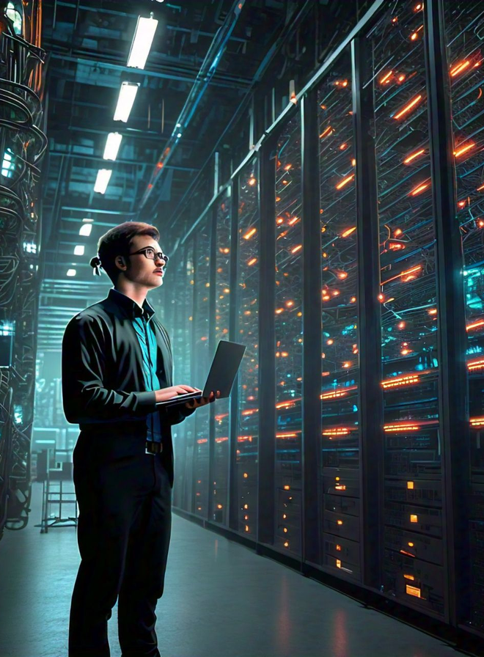
PURPOSE:
Store and analyze large datasets to improve matchmaking algorithms and track user behavior.
USE CASE:
Analyzing trends like user engagement and churn rates.
Training machine learning models for better recommendations.
BENIFITS:
Provides the ability to run complex analytical queries on vast datasets, helping Tinder optimize its user experience and business decisions.
Data Warehouses / Analytics Databases
alternate

Slide 13
why not amazon red shift or vertica database ?
Cost and Flexibility
Ease of Use
amazon red shift
vertica

Slide 14

Purpose:
Monitor real-time metrics for performance and system health.
USE CASE :
Tracking server loads and monitoring uptime.
Analyzing API response times to maintain smooth user interactions.
BENIFITS:
Enables efficient monitoring and troubleshooting of Tinder’s infrastructure, ensuring a consistent and responsive user experience.
Time-Series Databases
alternate

Slide 15
why not amazon red shift or vertica database ?
Purpose-Built for Monitoring
Integration with DevOps Tools
time-scale db
open ts db

Slide 16

Thank You

